Slide 1
Machine Learning Applications in Medicine Chronic Kidney Disease – Data Analysis, Graphs and Conclusions
Presenters
Dvir Amitay 318602638
Yuval Brunshtein 214445595
Osher Dighorkar 214097347
Lecturer: Orit Rephaeli
Group Number: 10

Slide 2
Introduction
In this work, our goal is to analyze patient data and examine the relationship between various variables and the mortality rate, using Machine Learning models and applying visualization and statistical techniques. In our case, the parameters were: Background Diseases Parameter – Chronic Kidney Disease (CKD) Vital Signs/Lab Results Parameter – Urinary Output (Urine Output) We will present how we worked with the data, the results and the graph which we achieve. Conclusions and Future Takes.

Slide 3

Understanding the data
The data was taken from: MIMIC-III Clinical Database Demo v1.4
Our comparison variable is Died in the hospital yes or no.
We will manipulate the data in order to obtain a simpler form of the data to use and apply analysis on.
We pull the relevant data out of our data tables into a single data table which the analysis will be performed on.
We will conduct a review of the type of variables identify missing data and outliers.

Slide 4

CKD – Chronic Kidney Disease
Chronic Kidney Disease -
Gradual Loss of Kidney Function
Can lead to Kidney Failure
Can lead to High Blood pressure
Can lead to swelling
Can cause higher rate of urinating

Slide 5
Data Analysis
In this analysis, we will want to study the differences between patients who have died and those who have survived, so we will focus mainly on:
3 Demographic parameters: age, gender, and ethnicity
in our vital variable
In our background disease variable
We will perform data analysis by:
Pre-processing the data
Graph Our data in different variations.
Perform Statistical Tests to evaluate our graphs and understand our data.

Slide 6
Results

Slide 7
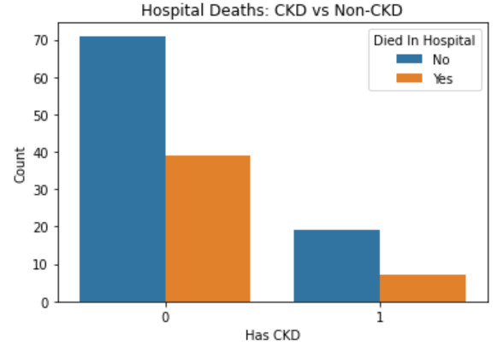
Number of deaths in a hospital with and without kidney disease

Slide 8
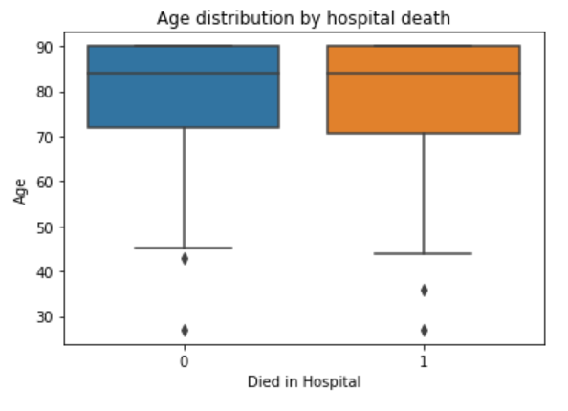
Mortality by age

Slide 9
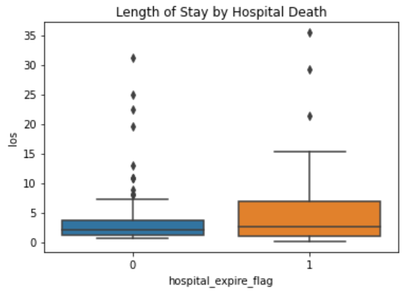
Number of deaths in relation to the length of stay in the hospital

Slide 10
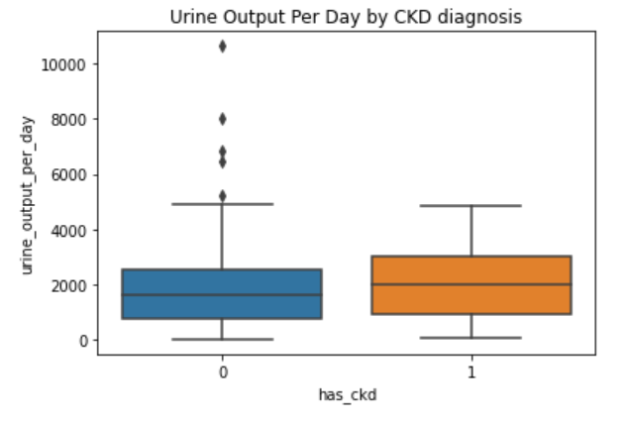
The relationship between Chronic Kidney Disease and Urine Output.

Slide 11
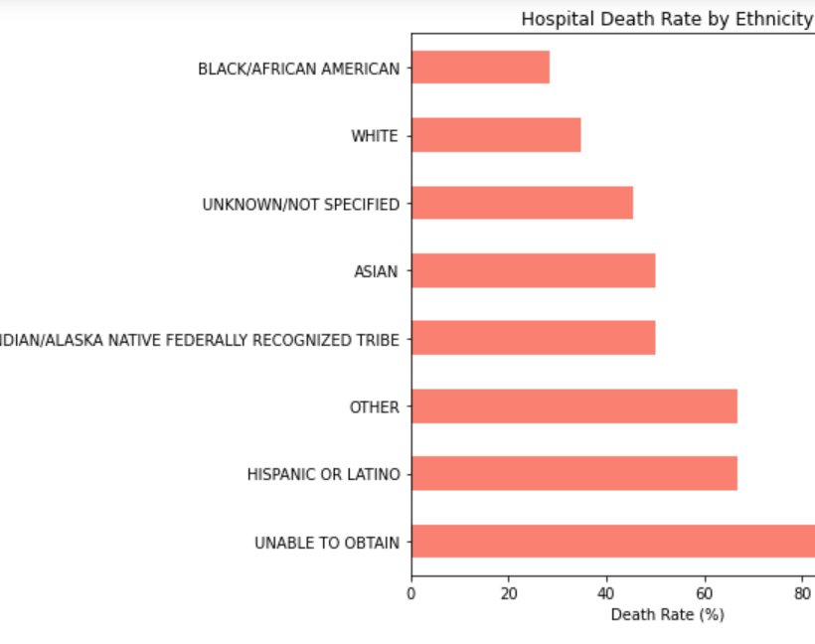
Mortality by ethnicity

Slide 12
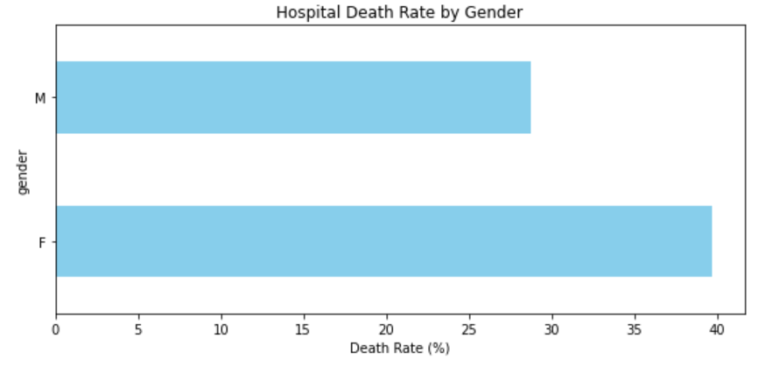
Death Rate In relation to Gender

Slide 13
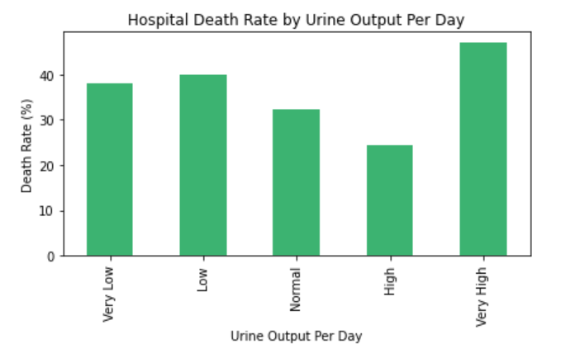
Mortality rate in relation to urinary output parameter

Slide 14
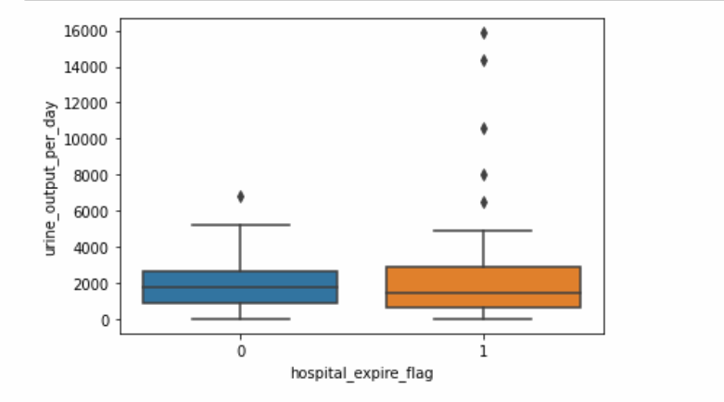
Urine Daily Output In Relation to Death

Slide 15
Chi-Squared Test
Purpose-tests the null hypothesis noted as H0 that the two variables are independent.
In our case checking if CKD binary status signifies the likelihood of death status.
P-value tells us if we reject or accept the null hypothesis.

Slide 16
Z-test proportionality measurement
Purpose – the comparison of proportions of a pre defined goal.
In our case the goal is defined as having a very high urine output per day. The null hypothesis is that the two groups have the same proportion of the pre defined goal.
Calculate the proportions of each group of the goal.
P-value tells us if we reject or accept the null hypothesis which states there is no difference in the pre defined goal parameter in both groups.

Slide 17

Summary and Conclusions
Statistical Analysis Results There is no significant relationship between the chronic kidney problem and the mortality rate in the hospital, as we found in the Chi-squared test, '
However, the Z-test showed that there are significant differences in urinary output expectancy between deceased patients and those who survived

Slide 18
Summary and Conclusions
Abnormal data in some of the indices, especially in extreme values of age, gender, and length of hospital stay, which may affect the results of the study and cause biases.

Slide 19
Summary and Conclusions
The analysis can be improved by advanced clearing of anomalies, expanding the sample size, and using more advanced machine learning models such as neural networks or models with better statistical calibration. In addition, examining the impact of other factors such as socioeconomic status, medical history, and access to medical care may yield additional insights and improve the quality of inference from the data

Slide 20
Summary and Conclusions
In topics of Machine Learning
Usage of Advanced Techniques in Machine Learning
The ancient reality of The Medical Industry
How the combination of the above bullet points saves lives and advance us as a society.

Slide 21
Thank You For Listening!

